Slide 1
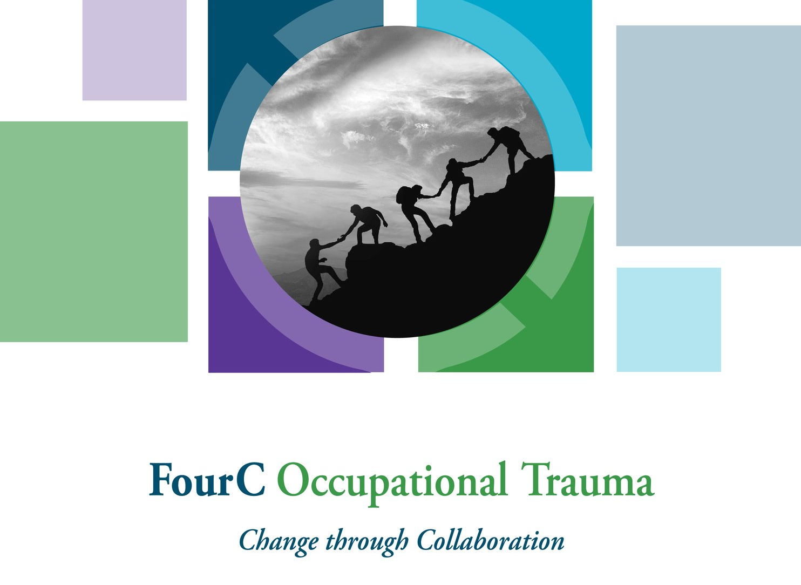
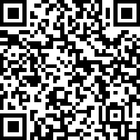
FourC Occupational Distress
Center on Trauma and Children
Scan the QR code to sign in, or use the link in the chat.
Notes:
Sign-in: https://uky.az1.qualtrics.com/jfe/form/SV_emNVmOg8CaljZYy

Slide 2

Please place your phone on mute unless you are speaking
Feel free to use the chat bar throughout!
PLEASE turn on your video camera
Notes:
Gin welcome

Slide 3
Faculty
Notes:
Insert faculty names

Slide 4

FourC Assessment
Notes:
Give 5 minutes at the start of the session for attendees to complete the FourC Assessment. Insert QR code or drop link in chat

Slide 5


Developers:
Ginny Sprang, Ph.D.
Stephanie Gusler, Ph.D.
Jessica Eslinger, Ph.D.
Reviewers:
Alison Hendricks, LCSW
Cambria Walsh, LCSW
UK Center on Trauma and Children 2024

Slide 6
Secondary Traumatic Stress
No trauma symptoms
Trauma symptoms and functional impairment but no PTSD
PTSD
Trauma symptoms but no functional Impairment
Sprang et al.,, 2022
Notes:
STS refers to trauma reactions that mimic PTSD symptoms due to indirect trauma exposure- hearing about, seeing, and having to recount trauma details. Indirect exposure to aversive details (e.g., during the course of one’s work) can constitute a trauma exposure according to the DSM 5. These reactions fall on a continuum of responses for those with indirect exposure. For some, mild or infrequent exposures may lead to no reactions, or mild transient reactions that last a brief time. Others will experience trauma symptoms in the domains of intrusion, avoidance, alterations in cognitions and mood and alterations in arousal and reactivity but will not have any functional impairment. The third group are those individuals with trauma symptoms that do impact daily functioning but these symptoms are not severe enough or broad enough for the individual to meet criteria for PTSD. And finally the most affected group are those who have these trauma symptoms that are severe and widespread, that have impacted their functioning and lasted atleast a month, and that meet criteria for PTSD. These individuals are those who indirect exposures are chronic and severe. So when we talk about STS, we are referring to responses that would fall along this continuum. STS can manifest as PTSD but is not reducible to PTSD.

Slide 7
Burnout
Moral Distress
Direct Trauma
Notes:
There are other conditions we are also concerned about- define each
Direct trauma exposure are experiences that meet Criterion A for PTSD (by the DSM 5) that is exposure to actual or threatened death, serious injury, or sexual violence. This exposure can be direct, witnessed, learned about via a close friend/
family member (if violent/accidental). As we mentioned, Indirect exposure to aversive details (e.g., during the course of one’s work) can constitute a trauma exposure but the experience is indirect. Example- being threatened by a client at work.
Burnout is a state of chronic emotional, physical, and mental exhaustion caused by prolonged, unmanaged stress, typically stemming from work, caregiving, or other high-pressure situations. It is not due to a trauma exposure. You can experience burnout regardless of where you work. Example: some workers may feel overworked and underpaid, and over time begin to lose the satisfaction associated with the work, they might become cynical, and detached from the job. But this is different than experiencing trauma symptoms due to indirect exposure at work.
Moral distress is the psychological, emotional, and physical suffering that occurs when a person knows the ethically correct action to take but feels constrained from acting on it. Commonly experienced in helping professions , it stems from institutional barriers, such as lack of resources, hierarchy, or policies that force individuals to act against their core values
These conditions are discreet but can co-exist

Slide 8
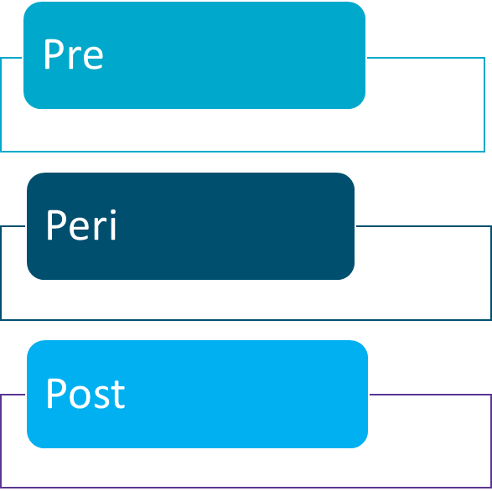
Conceptual Approach
Organizational
Individual
Socioecological and Systemic Context
Notes:
In this model, we are considering things from the pre (before exposure), peri (during exposure) and post (after exposure) perspective. Indirect exposures at work can occur frequently and repeatedly, but we know that there are things we can do in the pre exposure phase to build our skills and reactions to exposure that can make our responses in the peri and post phases smoother, because we have build up our skills and have some muscle memory to guide us. As we go through the training we will point out when (in terms of these phases) skill development and utilization is most useful.
We also know that individuals do not operate in isolation. We are part of organizational systems that have a role to play in creating healthy and safe environments for us to work in. These organizations are embedded in the larger socioecological context that influences how organizations operate and how we respond to things that happen at work. For example, if there is a lot of violence in the community and child services are not valued, the organization will be impacted by that. Likewise, the employees of this organization will be differentially impacted by these conditions, and may interpret events at work through that lens. In this training, we will focus on individual and organizational applications of these skills, with recognition that these larger systems will and do have an impact.

Slide 9
Goals of the Intervention
Calming
(Cognitive) Coping
Connection
Competency
Goal: Improve self-regulation, emotional processing and attentional control in the peri-traumatic phase to achieve a calm state that facilitates recovery and prevents destabilizing dysregulation
Goal: Manage intrusive thoughts and address unhelpful appraisals in the peri and post-trauma phases to enhance adaptive cognitive coping and reduce distress
Goal: To improve the worker’s relationship to their work, and to facilitate positive, energy enhancing supports in the workplace.
Goal: To enhance professional competence in handling occupational stress through the use of individual and organizational strategies that increase awareness of personal strengths and resources, and the ability to marshal these assets.
1
2
3
4
Notes:
Read the goals
Goal 1- Targets skills in the peri phase but practice in the pre stage really helps
Goal 2. Peri and post
Goal 3. Peri and post but works best if networks are already established
Goal 4. Pre and peri, reaffirming this in the post

Slide 10
FourC Occupational Trauma Skills
Calming
(Cognitive) Coping
Connection
Competency
C- Connect to self
A- Attention to the Positive
L- Leave it at Work
M- Make a connection
M- Manage Intrusions
I - Identify Unhelpful Appraisals
N- Notice, name and accept it
D- Determine org response
H- Help-seeking attitudes
E- Engage Supervisors
L- Lower Exposure
PS- Peer Support
Co- Communication
P - Problem-solving
E- Enhance Skills
1
2
3
4
Notes:
We will go through each of these skill sets as we explore each session
Point out mnemonic- A CALM MIND HELPS US COPE

Slide 11

Calming Session 1

Slide 12
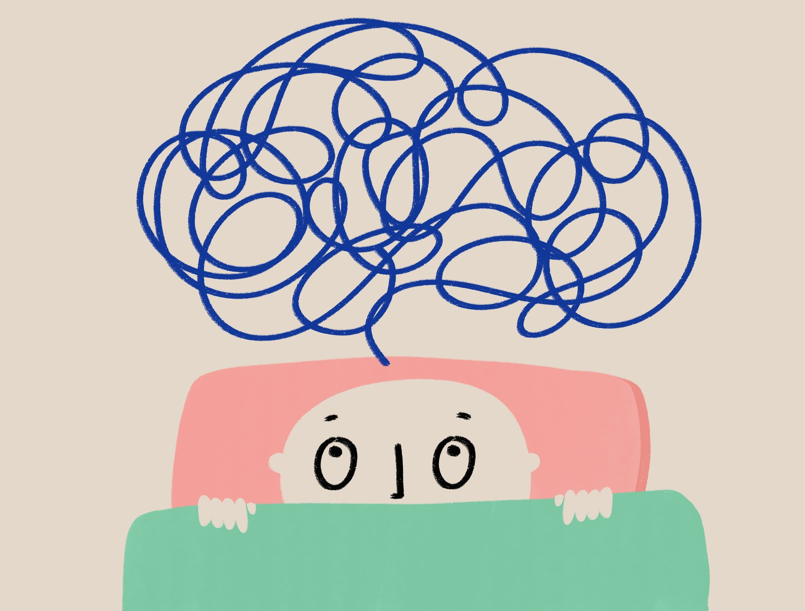
Notes:
Chaos is all around us. There is strife and high tension in our communities; organizations face challenges- threats to their functioning, leadership changes, job turnover; and as individuals we are negotiating the demands of our job with our personal lives that can be complicated, full and at times overwhelming.

Slide 13

Notes:
Or most pertinent to our topic today, being exposed to traumatic and tragic information in the context of a client encounter. Staying Calm is key to surviving and thriving in the face of occupational distress. When we can calm ourselves we stop negotiating with chaos

Slide 14

"In the light of calm and steady self-awareness, inner energies wake up and work miracles without any effort on your part"
Maharaj
Notes:
Can you think of a time this was true for you?
We have everything we need to manage the challenges of our days. But getting to our inner resources can be difficult. When our brains tell us there is danger we automatically react to protect ourselves. That is a good thing. It keeps us alive and safe. But what if the threat is consistent and not really life threatening? What if it is threat adjacent? Our clients trauma is not our trauma, but it reminds us of our vulnerability. Our clients trauma is not our trauma but the essence of it- the loss, the fear, seems familiar to us. Our clients trauma is not our trauma, but it is shocking, and not easily forgotten because we are humans who want to hold on the integrity of the human experience.
We have everything we need to manage these challenges, if we can stay calm enough to access our inner resources. That is what session 1 is all about, what can we do to remain calm so we can access our inner resources to cope with the challenges of our work

Slide 15
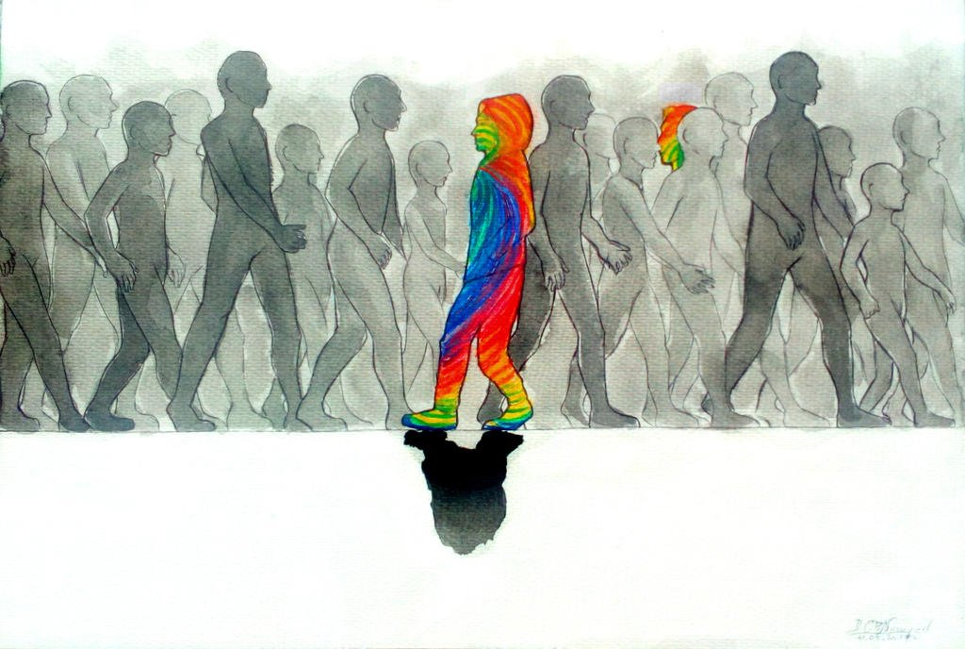
Disclaimer: Alone in the presence of another
This Photo by Unknown Author is licensed under CC BY-NC-ND
Notes:
Winnicot’s (1958) concept of “the capacity to be alone in the presence of another,” which, in his view, is one of the most important indications of emotional maturity is metaskill we are embracing in this training. Winnicott suggests
that the capacity to be alone first develops in the presence of a reliable mother, but it can be learned throughout life, and we are calling on it now, in this training.
In this FOURC training we are teaching intrapersonal skills that require quiet reflection and mindful presence- because of the nature of STS, a condition that occurs at work, you might need to execute these skills in the midst of chaos, and on the job in the presence of others.
In a parallel process we will be asking you to do this during these training sessions. To lean into the support and opportunities that the group and this process provides, but to resist the urge to let your social anxiety/ or the pressure of performing in a group dominate. We are asking you to cultivate your capacity to be alone with your thoughts in this space- in doing so, you are practicing the skills we are attempting to teach.

Slide 16

Pay Attention to Your SUDS
1
2
3
4
5
6
7
8
9
10
Notes:
This is a training and not therapy, so when you are reflecting and sharing with the group consider situations where the level of distress associated with the experience is a 5 or less on the SUDS (Subjective Units of Distress Scale) scale (your rating). We want these exercises to be meaningful to you, but want to control the level of distress that reflections might generate. Likewise, the details of a personal experience are less important than how the experience impacted you. So take care in sharing so that you do not inadvertently raise your level of stress.

Slide 17
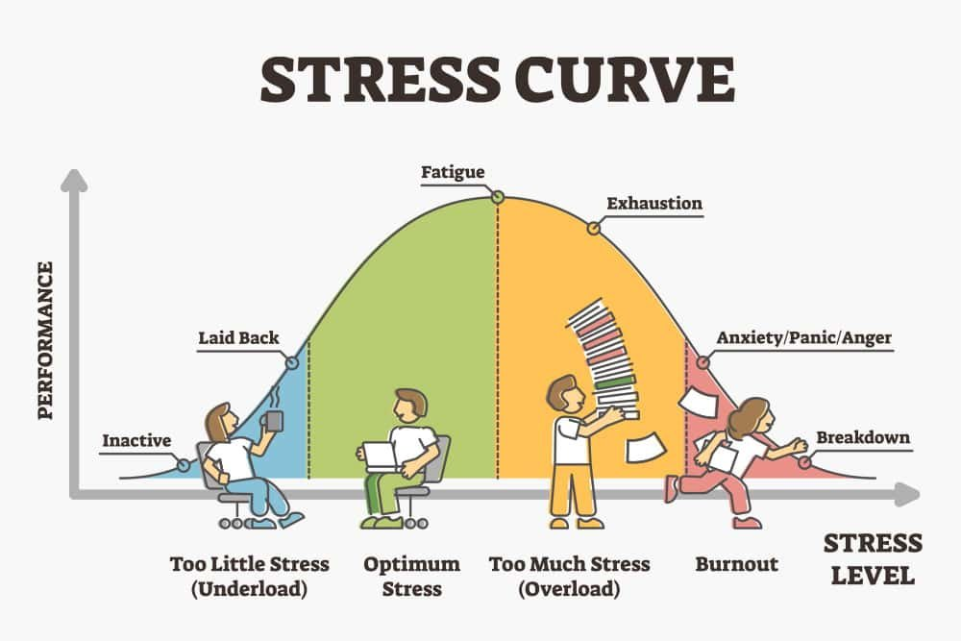
WOT
STS
Notes:
Talk through the stress continuum by describing what you see from left to right
Note how performance at both ends of the continuum is diminished for very different reasons. It is highest when we are in the window of tolerance and begins to diminish thereafter

Slide 18
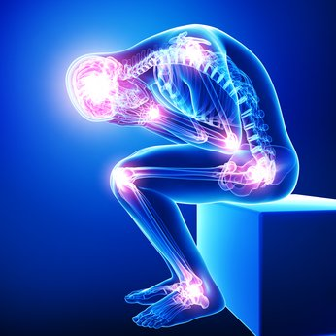
This Photo by Unknown Author is licensed under CC BY-NC-ND
Notes:
What was happening in your body when we are experiencing high levels of stress (extreme stress)?
Increased respirations, and changes in heart rate- which can cause dizziness, or lightheadedness-
Sweaty palms and tingling sensation, may experience shaking of limbs The shaking occurs because adrenaline that flood the system, This surge of energy primes muscles for immediate response, and the shaking is a physical release of that built-up tension.
Digestion slows because we don’t need to eat in an emergency, we may feel nauseous
Weakness in the knees or legs, a feeling you need to sit or you will fall. This is because of redirected blood flow (also called blood shunting), hyperventialation (which lowers carbon dioxide), and vagus nerve overstimulation which changes your hear rate, and can drop your blood pressure.
Auditory exclusion- diminished or complete loss of hearing for non-critical sounds, allowing focus on survival-related tasks
Sustained exposure to stress burns through energy reserves quickly, causing overall fatigue and a feeling of being physically drained
These physiological responses cue us to the fact we are having a stress response and need to calm down.
Much of this is invisible to others, but can be extremely destabilizing

Slide 19

Can you think of a time when you looked calm on the outside but felt distress on the inside?
This Photo by Unknown Author is licensed under CC BY-NC-ND
Notes:
At work, it may be difficult to notice when someone around you is dysregulated, this looks different for everyone. Similarly, what we project to others may be different than how we feel on the inside. This can cause problems because others may misinterpret our feelings, and we may miss out on opportunities for support. As you know being calm is not just about how we look on the outside. Trainer can give a personal example.
Can you think of a time when you looked calm on the outside but felt significant distress on the inside.. Give a moment for reflection
It is important that we recognize that as professionals many have mastered the skill of being an emotional container- you know this right- no matter what is happening around you, you have taught yourself to look calm, cool and collected” so as not to escalate the situation. To hold space for others to process big feelings without hurting others. But who holds space for you? How does your calm demeanor bely your inner state. How do we negotiate the balance between being an emotional container for others, and managing our own inner experience of alarm, distress and despair?

Slide 20
Why Calming Strategies are Needed Following Indirect Trauma Exposure
Peritraumatic responses can predict the trajectory of response
Peri traumatic conditions may create demands that may interfere with adaptive coping
Trauma exposure at work represents a violation or loss of territory- poor expectation alignment
Indirect trauma exposure may represent a trauma-reactivation
Indirect trauma exposure produces damaging effects on the professional’s sense of meaning
Notes:
Why are we talking about calming? Being calm is complicated and the cues we give others about our internal states can be masked by many things, inhibiting accesses to needed resources and responses-
Now we don’t expect workplace exposures to activate the same intensity of crisis response, but we do know that perceived threat can activate our bodies natural stress response. The sooner we can recognize it and activate our calming skills, the better off we will be. And we need to be able to ask for help in calming down when we feel dysregualted.
In the peri-traumatic phase the subjective experiences of threat and panic (indirect trauma exposure hogs the attentional spotlight, and keeps our attention within a limited range of experience- we then begin to focus only on the negative and bottom up processing that overwhelms us with sensory experience. Dissociation can lead to poorly elaborated, fragmented and sensory-based memories of the exposure. Cognitive and behavioral avoidance, negative appraisals of self and world, Rumination and persistent dissociation are associated with a more troubled trajectory
There are peri traumatic conditions may create demands that may overwhelm or interrupt adaptive coping. This could be due to
professional responsibilities that prohibit processing or attending to one’s emotional response in the moment because a client safety and needs come first
Organizational resources may be limited or are not readily available to attenuate peri-trauma responses
Professionals may feel they will be punished or stigmatized by acknowledging harm or utilizing coping resources
Trauma exposure at work represents a violation or loss of territory (i.e. perception that work is a safe space). One may assume that their workplace is safe, and not the place where physical or psychological harms will occur. This is what we call poor expectation alignment
Indirect trauma exposure may represent a trauma-reactivation of primary traumas that occurred earlier in life or outside of work
Indirect trauma exposure produces damaging effects on the professional’s sense of meaning, justice, and order, which can activate a stress response

Slide 21
Calming
Goal: Improve self-regulation, emotional processing and attentional control in the peri-traumatic phase to achieve a calm state that facilitates recovery and prevents destabilizing dysregulation
Notes:
Reminder of the goal- read slide

Slide 22
Session 1 Calming
C
A
CALM
M
L
C- Connect to self
A- Attention (Balanced) to
Positive
L- Letting Go
M- Make a connection
Notes:
These are the skills we will focus on in Session 1 using our Mnemonic of CALM

Slide 23
Session 1 Calming
C
Connect to Self
Mindful Awareness
Breathing alignment- physiological sigh
Mindfulness self-compassion
CALM
Notes:
Lets start with the C- connecting to self. We will accomplish this through breathing alignment and some mindfulness self compassion. There are other ways, but we selected these two strategies because they are easy to use, and highly effective

Slide 24

Notes:
Read the quote
Breathing Alignment- one of the first things that happens when we become distressed is our respiration changes. Remember an alarm response is caused by bottom up processing so we need a bottom up stress management technique to address this. The “physiological sigh” is an example of a bottom-up stress management technique that can be used acutely to reduce stress or anxiety quickly and in any situation. It is helpful because you can use this in the moment, you don’t have to wait to get to a calm place. This pattern of breathing is what our bodies normally do when we are crying very hard, are in a claustrophobic environment, or deep sleep. This pattern of breathing signals our body that we need to calm down and self regulate our breathing. When our carbon dioxide levels get too high, our bodies automatically engage in a physiological sigh. Unfortunately, this breathing pattern doesn’t always come right when we need it, but we can activate it our selves.
How it works: A sigh starts out as a normal breath, but before you finish the exhale, you take a second breath on top of it, The first inhale fills the lungs, and the second inhale fully inflates the remaining alveoli (air sacs) in the lungs, maximizing oxygen intake. This is then followed by an extended exhalation of atleast three seconds. The long, slow exhale helps to clear out excess carbon dioxide and activates the parasympathetic nervous system, which is responsible for the body's "rest and digest" response.
Demonstrate this for the group- two or three times

Slide 25

Calm Yourself with the Physiological Sigh
Calm Yourself with the Physiological Sigh
Inhale, then before you get to the top, inhale again
Expel your breath with a long exhale (Rest and Digest)
Wait 5 seconds and do it again
Do this 5 times
Notes:
Lets practice together- (give directions. It is very important that there is a period of pause between physiological sighs so the person doesn’t hyperventilate)
After the practice- there are some benefits to this approach
Stress and Anxiety Reduction: By activating the parasympathetic nervous system, the physiological sigh can quickly lower heart rate, reduce feelings of stress and anxiety, and promote a sense of calm.
Emotional Regulation: The technique can be used to reset emotional states, helping to regain composure during moments of overwhelm or anxiety.
How did it feel to do this?

Slide 26

Of all mines of treasure, one's own is the last to be dug up."–Friedrich Nietzsche
Notes:
Read quote
The Physiological Sigh is just one of gem in our treasure box of resources available to us- that doesn’t require anyone else or a special condition- we can access it whenever we want to calm down

Slide 27

Breathing Compassion
In and Out
This Photo by Unknown Author is licensed under CC BY-ND
Notes:
So we are going to practice another calming down technique- have people turn away from others if in person or can turn off cameras
We are going to start with a metta meditation- it is a mindfulness exercise that will help calm our bodies and minds. Research tells us that mindfulness meditations like the one we are going to do now may enhance or attention control, and help us self-regulate self-regulation (Tang et al., 2015;2016; Loucks et al., 2015; Guendelman et al., 2017) by increasing cognitive resources such as our ability to reappraise situations (Tang et al., 2016) and modifying how we processing events such as reducing or ruminations and enhancing our bodily awareness Holzel et al., 2011).
Note: you can modify this based on time
Remarks
One of the most widely practiced
meditations in the world. It is an
exercise for beginners that you
can do for the rest of your life.
Developed by : CAPT Candace Y. Hander RDH MS Dec 19, 2017
1. Sit down, close your eyes, and direct your attention to your breathing.
2. Be aware of every breathing in and breathing out.
3. Let your breathing be something automatic and do not try to steer it.
4. Observe how the air slowly goes in through your nose, fills up your lungs, and goes out again.
5. Slowly withdraw all of your attention from all sounds in the room.
Loving-Kindness (Metta) Meditation
6. When, after a few breaths, you really feel at ease, you begin:
7. Begin by using visualization, and bring up a mental picture. See yourself smiling at your own
reflection.
8. Repeat the following phrase, silently:
May I be happy. May I be well. May I be safe. May I be peaceful and at ease.
May I be happy. May I be well. May I be safe. May I be peaceful and at ease.
May I be happy. May I be well. May I be safe. May I be peaceful and at ease.
As you say these phrases, sink into their intention and heartfelt meaning.
9. After a period of directing Loving-kindness towards yourself,
10. Imagine a person close to you who loves you very much. It can be someone past or present, living
or dead, it can also be a spiritual teacher of guide.
11. See that person in front of you, smiling back at you.
12. Imagine that person is sending you their warm wishes and love, wishing you perfect wellness and
happiness. With every breath, you feel the positive energy stream into your being.
13. Then imagine that you are also sending that same feeling of love, happiness, and well-being back
to that person.
14. Repeat the following phrase, silently:
May you be at ease, may you be happy, may you be at peace.
May you be at ease, may you be happy, may you be at peace.
May you be at ease, may you be happy, may you be at peace.
As you say these phrases, sink into their intention and heartfelt meaning.
Think of the person that you are experiencing difficulty with, and see yourself with that person smiling
back at you. Repeat the following phrase silently:
Just as I wish to be, may you be happy, may you be healthy, may you be free from all pain.
Just as I wish to be, may you be happy, may you be healthy, may you be free from all pain.
Just as I wish to be, may you be happy, may you be healthy, may you be free from all pain.
As you say these phrases, sink into their intention and heartfelt meaning.
17. When you breathe in, take in this wonderful feeling of love, and when you breathe out, you
imagine that all negative feelings escape from your body together with the air you breathe out.
18. Now imagine all beings everywhere without distinction.
19. Repeat the following phrase silently:
May you be happy, may you be healthy, may you be free from all pain.
May you be happy, may you be healthy, may you be free from all pain.
May you be happy, may you be healthy, may you be free from all pain.
20. Slowly bring your attention back to your breath. Be aware of every breathing in and breathing out.
21. Slowly take your attention back to the rest of your body and the sounds in the room.
22. Move a little, stretch your muscles, and open your eyes.
23. Notice your state of mind, and how you feel after this meditation.

Slide 28

WHY?
• It improves your
Concentration.
• It gives you a clear,
calm mind.
• It improves your
breathing.
• It changes your perspective.
• It stops bottom up processing.
Notes:
Advantages
• It improves your
concentration
• It gives you a clear,
calm mind.
• It improves your
breathing.
• It changes your perspective.
• It stops bottom up processing

Slide 29
Consider ways you can use the calming strategies of Physiological Sigh and Compassion-Based Practices in your own professional life.
When can you use these skills?
Who at work can you teach these skills to?
Notes:
Break out discussion 5 min

Slide 30
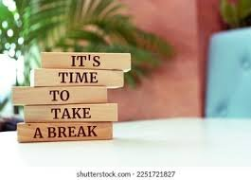
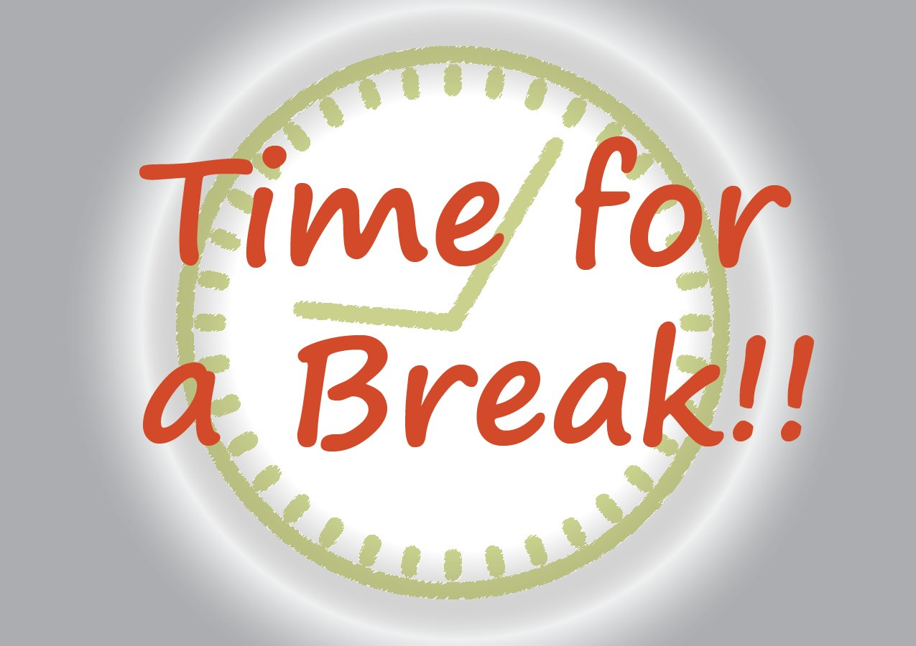
Notes:
5 minutes

Slide 31
Session 1 Calming
A
Attention to the Positive- Balancing out Negativity
CALM
  Floodlight/Flashlight
  Reflection and Application to Work

Slide 32



This Photo by Unknown Author is licensed under CC BY-SA
This Photo by Unknown Author is licensed under CC BY-NC
Notes:
“Attention regulates how you perceive your life, think your thoughts, feel your feelings, enjoy your memories, and daydream about the future.” Jha explains that each of us has a highly tuned, three-part “attention system” that acts like a master conductor in our brains and coordinates with our working memory system to stash ideas and experiences where we can find them later.
Your “attention system” is made up of three subsystems that work together, allowing you to successfully function in your own complex life
The Flashlight
That’s when your attention is focused and wherever you point it, that becomes brighter, highlighted, more salient in your mind. For example, let’s say you need your car keys. You walk around your apartment, looking for their, shape, texture and voila, there they are. Thank you, Flashlight.
The Floodlight
Where the Flashlight is narrow and focused, the Floodlight is broad and open. Now that you’ve found your keys, you drive to the store. Your Floodlight is watching the road, looking out for stop signs, keeping an eye on your speed, watching out for pedestrians and cyclists. You’re not looking for anything in particular but you’re ready to whip out your Flashlight if you need to respond to something that needs your focused attention.
The Juggler
The Juggler directs, oversees, and manages what you’re doing minute to minute. As Jha says, the Juggler “ensures that our actions are aligned with what we’re aiming to do.” That is, the Juggler keeps your goals in mind so your behavior stays on track and delivers (when you pull into the parking lot and check your text messages, the Juggler nudges you to stop scrolling and get to the store).
Pay attention to your attention
Your working memory enables these three subsystems to coordinate their roles inside your brain. “Your working memory is like a scratch pad. It is a kind of temporary “workspace” in the brain where you can manipulate the Flashlight, Floodlight, and Juggler information over very short periods of time, from a few seconds to a minute, max,” says Jha.
Anytime you pay attention (Flashlight, Floodlight, or Juggler), the information that’s being processed is temporarily stored in your working memory. Together, the attention and working memory systems form the contents of your conscious experience, and they enable you to use that information as you go through life.
“Your attention is powerful, but it’s not invincible,”
What happens to attention when we are threatened
attentional control theory asserts that stress places significant demands on an individual’s cognitive resources and impairs attentional processes (Eysenck, Derakshan, Santos, & Calvo, 2007). It may be that stress enhances vigilance and attention towards threatening stimuli. So you become like a fliashlight and focus only on the threat and anything that looks like threat- OR you could get stuck in your floodlight- so worried about the big picture you cannot focus or connect to tasks in front of you. Threat also slows down the juggler, we forget to maintain balance because we are stuck in one mode or another
When this happens there are skills we can use to intentionally force ourselves between flashlight and floodlight and bring the juggler onboard. A daily practice of mindfulness meditation—“anchoring your attention in the present moment and experiencing it without editorializing making up a story about what’s happening or will happen”—can clear mental fog, declutter the mind, and strengthen mental focus so you can experience more of your life.

Slide 33

Floodlight
Flashlight Exercise
Notes:
Perspective shifting and leveling are key- “A person that flies from their fear may find they have only taken a shortcut to meet it” JRR Tolkien but shifting perspective allows us to tolerate our fears in new ways
Get yourself in a comfortable position in your chair, and take a couple of deep breaths.
Lets start with the floodlight. Look all around you, naming everything you see in detail (example: I see a three-story house with red brick and black roof, three dormers on the roof. There are green shrubs that surround 7 steps up to the front door. The drive way is on the left of the house. It is a pretty house.” You get the idea). When you want move to the next thing you see and describe it. Move from one thing to another this way as fast or as slow as you want. If your mind wanders just notice this and say to yourself “my mind is wandering” and then refocus on noticing and describing what you see”.
Now shift your attention to your hands, turn off your floodlight and get out your flashlight. Notice the shape of your fingers and the lines on your skin. Open and close your hands and notice how the skin stretch and relaxes as you do so. Place your palms together and notice how it feels for your hands to touch. Notice if your hands are warm, cold or just right. If you notice you are judging your hands, just observe that and say “I am judging my hands but I don’t need to do that”. Now put your hands right in front of your face- notice the lines on your palms, the character of your hands.
Now close your eyes and turn your attention to your breath. How does it feel to breath deep and exhale. What happens to your ribcage, your sternum. How does it feel when you notice your breath coming in and out. If your mind wanders and you find yourself opening your eyes and wanting to turn on the floodlight, just notice that, close your eyes and refocus on your breathing. Take 10 deep breaths, counting each one out loud with your eyes closed.
Now think of something positive in your life, a person, a condition, and thing and shine the flashlight on this positive aspect of your life. Think of how this positive aspect of your life makes you feel. Shine the flashlight so that all facets of the person, place, thing or condition are highlighted.
Now open your eyes and thank your internal juggler for allowing you to be the master of your attentional spotlight. Observe how well your internal juggler did its job and let you take the reins. Identify this ability to take attentional control as a skill that you can use when you need it. Remember both your flashlight and floodlight are useful and important for survival, but they can get stuck in the on position when we don’t need them and keep us stressed, even when the danger has passed. Thank yourself for engaging in this exercise.
Practicing this cognitive shifting creates muscle memory that can be useful after a stressful encounter at work. When you are stressed and find yourself stuck in a painful encounter or hypervigilant in your environment, ask yourself- Is my floodlight or flashlight engaged” and practice shifting from one to another until you gain some balance.
Personal reflection- At work, when do I need to practice the flashlight/floodlight exercise????

Slide 34
At work, when do I need to practice the flashlight/floodlight exercise?
Notes:
Insert a QR code here to do this as a Mentimeter activity. Alternatives would be group discussion or short break out

Slide 35

Session 1 Calming
Let it Go
CALM
L
You are not your thoughts.
Your thoughts are not you.
Notes:
Next we are going to focus on letting it go- Sometimes in the midst of a threatening situation, we get a thought in our mind that can drive the way we feel without even realizing it. Even if we notice we are thinking in a way that isn’t helpful it can be difficult to let go of the thought and achieve a calm state. The Leaves on a stream exercise is a cognitive defusion exercise that helps us focus on letting go of unwanted and unhelpful thoughts in a mindful way so we can calm ourselves. Cognitive Defusion is a technique of distancing ourselves from harmful thoughts, In this exercise we are going to focus on noticing them and letting them go. The motto here is you are not your thoughts, your thoughts are not you.

Slide 36
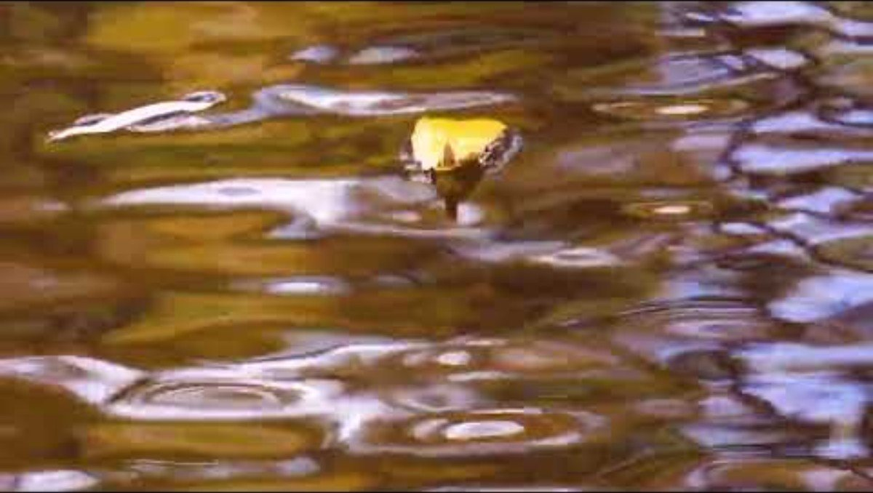

Slide 37

What do you need to let go of at work?
Notes:
How did it feel to do this exercise of letting go?
What do you need to let go of at work?
Do this as a Mentimeter activity and insert QR code

Slide 38

Session 1 Calming
Make a Work Connection
CALM
M
Notes:
We are now on our final calming strategy which is to Make a Work Connection to reinforce these skills. We want to think about ways that the organization and our peers/supervisors can support the use of some of these calming down skills. We would like to challenge you to reach out to an End of the Day Resilience Buddy. This is a person who you will do end of the day check ins with and hold each other accountable for using the skills of connecting to the self, attentional control, and letting go. This can be structured or unstructured but one way to get the conversation going is to meet at the end of the day via email, text, face to face, whenever and wherever is comfortable for you

Slide 39

Homework Activity #1 Brief End-of-Day “Buddy Reflections”
    What am I grateful for today?
    What do I need to let go of?
    What is my intention for tomorrow?
Notes:
Questions to ask End of the Day Resilience Buddy
• What am I grateful for today?
• What do I need to let go of?
• What is my intention for tomorrow?
Again- This can be done via email, over a cup of coffee, during a walk on a break- anyway you want to do it
Take a minute and identify someone at your workplace (or in a similar job) that could be your resilience buddyWho should you ask- you pick- it could be a friend or someone you want to connect with (a new member of your support network, a potential mentor, someone more senior to you, or someone that you think could use some support). It should be voluntary to work

Slide 40
More End-of-the-Day “Buddy Reflections”
What was the best part of my day today and who or what made it the best part?
What did this (encounter) teach me?
What one thought helped me today?
Are there any words from a colleague that you are grateful for today?
What am I most proud of today?
Notes:
Other questions resilience buddies could ask during this exchange:
What was the best part of my day today and who or what made it the best part?
What did this teach me?
What one thought helped me today?
Are there any words from a colleague that you are grateful for today?
What am I most proud of today?
Can you think of other good questions to ask? Have them drop in chat.

Slide 41
Organizational Strategies to Reinforce End-of-the-Day Reflections
1) If you are a supervisor, incorporate this into a check-in with your supervisees during supervision. Model by sharing your own reflections.
2) These questions could be sent out via a Teams message asking your team or work group to reflect on these questions;
3) One of these questions could be posed during a staff meeting, with round robin reflections
Notes:
Organizational approaches to this exercise
1) If you are a supervisor, incorporate this into a check in with your supervisees during supervision. Model by sharing your own reflections;
2) These questions could be sent out via a Teams message asking your team or work group to reflect on these questions;
3) These questions can be posed during a staff meeting, with round robin reflections
Remember the goal is to increase self awareness, attentional control by attending to the positive, and letting go of what is no longer useful but this exercise also has the benefit of creating social connection and support as well, and allowing us to recognize and shift our perspective.

Slide 42
Organizational Efforts to Support End-of-the-Day Reflections- Breakout
What can supervisors or senior leaders, do to integrate Buddy Reflections into the workplace culture?
Notes:
What could senior leaders or supervisors do to integrate Buddy Reflections into the workplace culture 7 minutes

Slide 43

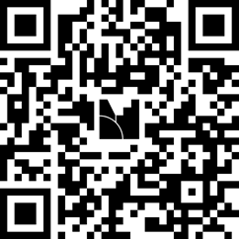
What is one key takeaway from today’s session that you are willing to try?
Notes:
10 minutes as round robin

Slide 44

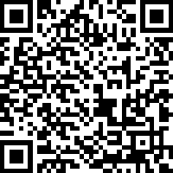
Gives us your feedback!
Give Us Your Feedback!
Scan the QR code to sign out, or use the link in the chat.
Notes:
https://uky.az1.qualtrics.com/jfe/form/SV_3K927BDMcEoNE8e

